Slide 1
Chapter 7 Single-Dimensional Arrays

Slide 2
Objectives
To declare, create, and initialize an array.
To program common array operations (displaying arrays, summing all elements, finding the minimum and maximum elements, random shuffling, and shifting elements).
To simplify programming using the foreach loops.
To copy contents from one array to another.
To develop and invoke methods with array arguments and return values.
To search elements using the linear or binary search algorithm.
To sort an array using the selection sort approach.

Slide 3
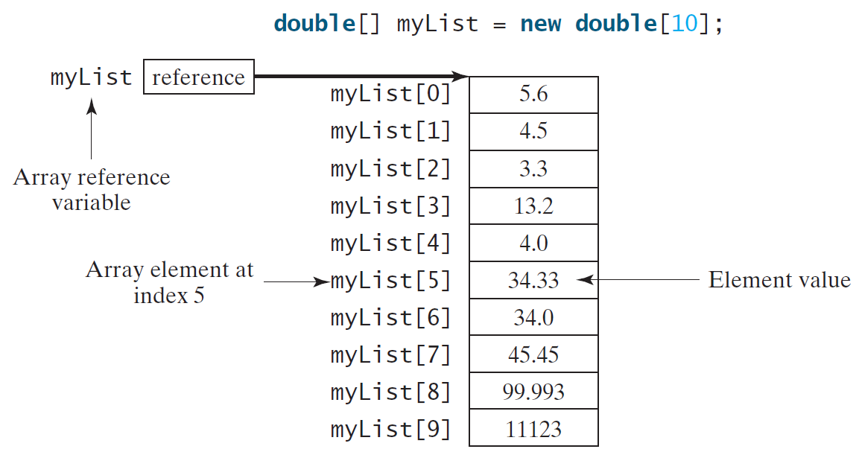
Introducing Arrays
Array is a data structure that represents a collection of the same types of data.
You can find the array size using the length property.
myList.length returns 10

Slide 4
Declaring & Creating Array Variables
Declaring an array variable
double[] myList;
OR
double myList[]; // This style is allowed, but not preferred
Creating an array variable
myList = new double[10];
Declaring and creating in one step
double[] myList = new double[10];

Slide 5
Indexed Variables
The array elements are accessed through the index.
The array indices are 0-based, i.e., it starts from 0 to arrayRefVar.length-1.
For the following array: double[] myList = new double[10];
myList[0] references the first element in the array.
myList[9] references the last element in the array.

Slide 6
Default Values
When an array is created, its elements are assigned the default value of
0 for the numeric primitive data types,
'\u0000' for char types, and
false for boolean types.

Slide 7
Declaring, creating, initializing Using the Shorthand Notation
double[] myList = {1.9, 2.9, 3.4, 3.5};
This shorthand notation is equivalent to the following statements:
double[] myList = new double[4];
myList[0] = 1.9;
myList[1] = 2.9;
myList[2] = 3.4;
myList[3] = 3.5;

Slide 8
CAUTION
Using the shorthand notation, you have to declare, create, and initialize the array all in one statement. Splitting it would cause a syntax error. For example, the following is wrong:
double[] myList;
myList = {1.9, 2.9, 3.4, 3.5};

Slide 9
Processing Arrays
(Initializing arrays with input values)
(Initializing arrays with random values)
(Printing arrays)
(Summing all elements)
(Finding the largest element)
(Finding the smallest index of the largest element)
(Random shuffling)
(Shifting elements)

Slide 10
Initializing arrays with input values
double[] myList = new double[4];
java.util.Scanner input = new java.util.Scanner(System.in);
System.out.print("Enter " + myList.length + " values: ");
for (int i = 0; i < myList.length; i++)
myList[i] = input.nextDouble();

Slide 11
Initializing arrays with random values
double[] myList = new double[4];
for (int i = 0; i < myList.length; i++) {
myList[i] = Math.random() * 100;
}

Slide 12
Printing arrays
double[] myList = {1.9, 2.9, 3.4, 3.5};
for (int i = 0; i < myList.length; i++) {
System.out.print(myList[i] + " ");
}

Slide 13
Summing all elements
double[] myList = {1.9, 2.9, 3.4, 3.5};
double total = 0;
for (int i = 0; i < myList.length; i++) {
total += myList[i];
}

Slide 14
Finding the largest element
double[] myList = {1.9, 2.9, 6.3, 3.4, 3.5};
double max = myList[0];
for (int i = 1; i < myList.length; i++) {
if (myList[i] > max)
max = myList[i];
}

Slide 15
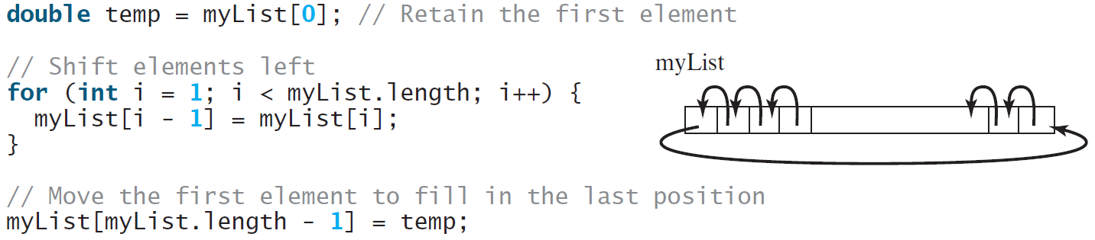
Shifting Elements
double[] myList = {1.9, 2.9, 3.4, 3.5};

Slide 16
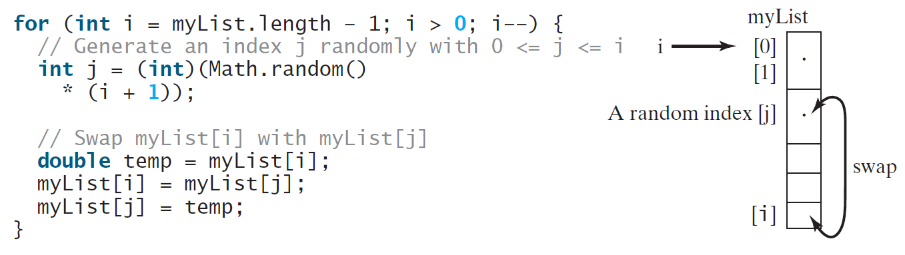
Random shuffling
double[] myList = {1.9, 2.9, 3.4, 3.5};

Slide 17
Enhanced for Loop (for-each loop)
JDK 1.5 introduced a new for loop that enables you to traverse the complete array sequentially without using an index variable. For example, the following code displays all elements in the array myList:
double[] myList = {1.9, 2.9, 3.4, 3.5};
for (double value: myList)
System.out.println(value);
In general, the syntax is
for (elementType value: arrayRefVar) {
// Process the value
}
You still have to use an index variable if you wish to traverse the array in a different order or change the elements in the array.

Slide 18
Problem: Deck of Cards
The problem is to write a program that picks four cards randomly from a deck of 52 cards.
All the cards can be represented using an array named deck, filled with initial values 0 to 51, as follows:
int[] deck = new int[52];
// Initialize cards
for (int i = 0; i < deck.length; i++)
deck[i] = i;

Slide 19
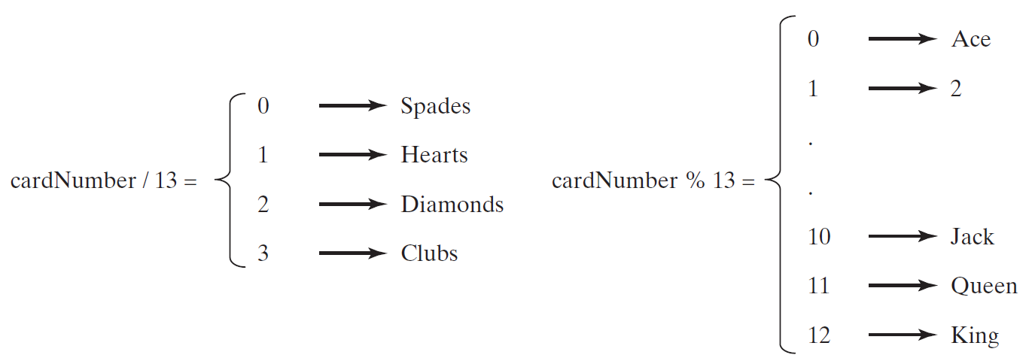
Problem: Deck of Cards, cont.
cardNumber ranges from 0-51

Slide 20
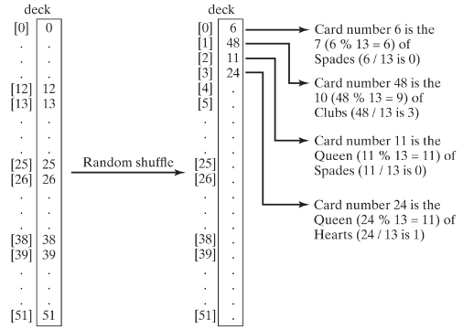
Problem: Deck of Cards, cont.

Slide 21
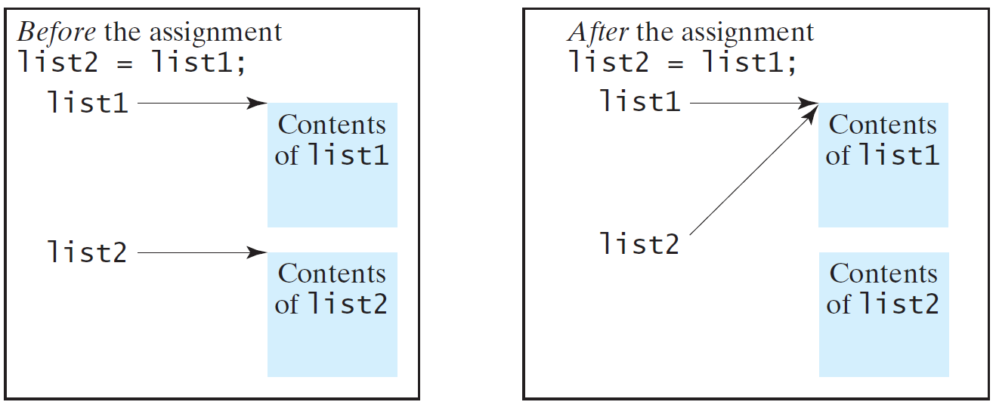
Copying Arrays
Often, in a program, you need to duplicate an array or a part of an array. In such cases you could attempt to use the assignment statement (=), as follows:
list2 = list1;

Slide 22
Copying Arrays
Using a loop:
int[] sourceArray = {2, 3, 1, 5, 10};
int[] targetArray = new int[sourceArray.length];
for (int i = 0; i < sourceArrays.length; i++)
targetArray[i] = sourceArray[i];

Slide 23
The arraycopy Method
arraycopy(sourceArray, src_pos, targetArray, tar_pos, length);
Example:
System.arraycopy(sourceArray, 0, targetArray, 0, sourceArray.length);

Slide 24
Passing Arrays to Methods
public static void printArray(int[] arr) {
for (int i = 0; i < arr.length; i++) {
System.out.print(arr [i] + " ");
}
}
Invoke the method
int[] list = {3, 1, 2, 6, 4, 2};
printArray(list);
Invoke the method
printArray(new int[]{3, 1, 2, 6, 4, 2});
Anonymous array

Slide 25
Pass By Value
Java uses pass by value to pass arguments to a method. There are important differences between passing a value of variables of primitive data types and passing arrays.
For a parameter of a primitive type value, the actual value is passed. Changing the value of the local parameter inside the method does not affect the value of the variable outside the method.
For a parameter of an array type, the value of the parameter contains a reference to an array; this reference is passed to the method. Any changes to the array that occur inside the method body will affect the original array that was passed as the argument.

Slide 26
Simple Example
public class Test {
public static void main(String[] args) {
int x = 1; // x represents an int value
int[] y = new int[3]; // y represents an array of int values
m(x, y); // Invoke m with arguments x and y
System.out.println("x is " + x);
System.out.println("y[0] is " + y[0]);
}
public static void m(int number, int[] numbers) {
number = 1001; // Assign a new value to number
int[] temp = {10,20,30};
numbers = temp;
}
}
Changes are not reflected back if we assign reference to a new object.

Slide 27
Simple Example
public class Test {
public static void main(String[] args) {
int x = 1; // x represents an int value
int[] y = new int[3]; // y represents an array of int values
m(x, y); // Invoke m with arguments x and y
System.out.println("x is " + x);
System.out.println("y[0] is " + y[0]);
}
public static void m(int number, int[] numbers) {
number = 1001; // Assign a new value to number
numbers[0] = 5555; // Assign a new value to numbers[0]
}
}
Changes are reflected back if we do not assign reference to a new object.

Slide 28
Returning an Array from a Method
public static int[] reverse(int[] list) {
int[] result = new int[list.length];
for (int i = 0, j = result.length - 1;
i < list.length; i++, j--) {
result[j] = list[i];
}
return result;
}
list
result
int[] list1 = {1, 2, 3, 4, 5, 6};
int[] list2 = reverse(list1);

Slide 29
Searching Arrays
Searching is the process of looking for a specific element in an array; for example, discovering whether a certain score is included in a list of scores.
Searching is a common task in computer programming. There are many algorithms and data structures devoted to searching.
We will look at two commonly used approaches, linear search and binary search.

Slide 30
Linear Search
The linear search approach compares the key element, key, sequentially with each element in the array list.
The method continues to do so until the key matches an element in the list, or the list is exhausted without a match being found.
If a match is found, the linear search returns the index of the element in the array that matches the key.
If no match is found, the search returns -1.

Slide 31
Linear Search
/** The method for finding a key in the list */
public static int linearSearch(int[] list, int key) {
for (int i = 0; i < list.length; i++)
if (key == list[i])
return i;
return -1;
}
Trace the method
int[] list = {1, 4, 4, 2, 5, -3, 6, 2};
int i = linearSearch(list, 4); // returns 1
int j = linearSearch(list, -4); // returns -1
int k = linearSearch(list, -3); // returns 5

Slide 32
Binary Search
For binary search to work, the elements in the array must already be ordered.
The binary search first compares the key with the element in the middle of the array.
Consider the following three cases:
If the key is less than the middle element, you only need to search the key in the first half of the array.
If the key is equal to the middle element, the search ends with a match.
If the key is greater than the middle element, you only need to search the key in the second half of the array.

Slide 33
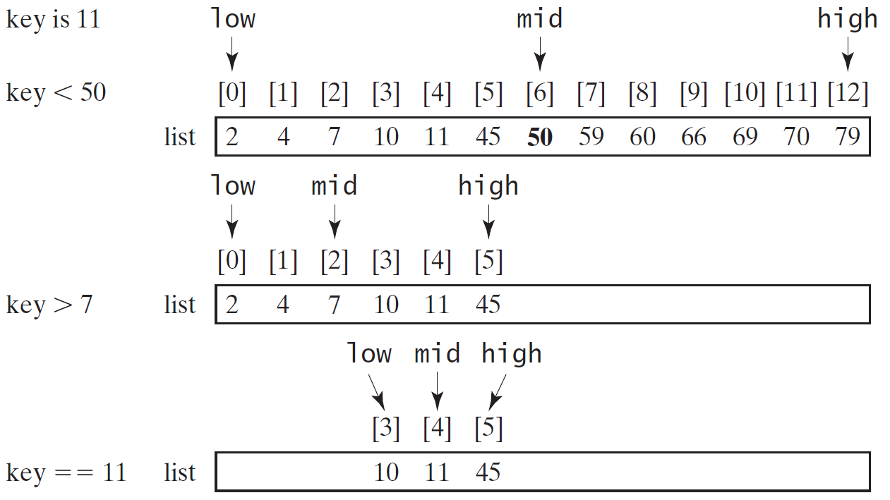
Binary Search, cont.

Slide 34
Binary Search, cont.

Slide 35
Binary Search, cont.
The binarySearch method returns the index of the element in the list that matches the search key if it is contained in the list. Otherwise, it returns
-insertion point - 1.
The insertion point is the point at which the key would be inserted into the list.

Slide 36
From Idea to Soluton
/** Use binary search to find the key in the list */
public static int binarySearch(int[] list, int key) {
int low = 0;
int high = list.length - 1;
while (high >= low) {
int mid = (low + high) / 2;
if (key < list[mid])
high = mid - 1;
else if (key == list[mid])
return mid;
else
low = mid + 1;
}
return -1 - low;
}

Slide 37
The Arrays.binarySearch Method
Since binary search is frequently used in programming, Java provides several overloaded binarySearch methods for searching a key in an array of int, double, char, short, long, and float in the java.util.Arrays class. For example, the following code searches the keys in an array of numbers and an array of characters.
int[] list = {2, 4, 7, 10, 11, 45, 50, 59, 60, 66, 69, 70, 79};
System.out.println("Index is " + java.util.Arrays.binarySearch(list, 11)); // Returns 4
char[] chars = {'a', 'c', 'g', 'x', 'y', 'z'};
System.out.println("Index is " + java.util.Arrays.binarySearch(chars, 't’)); // Returns -4
For the binarySearch method to work, the array must be pre-sorted in increasing order.

Slide 38
Sorting Arrays
Sorting, like searching, is also a common task in computer programming.
Many different algorithms have been developed for sorting.
We will look at a simple, intuitive sorting algorithms: selection sort.

Slide 39
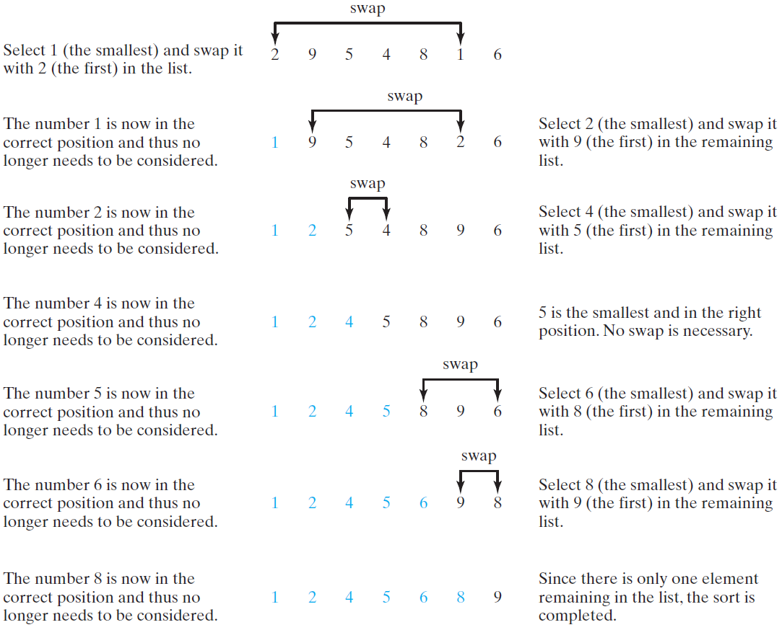
Selection Sort
Selection sort finds the smallest number in the list and places it first. It then finds the smallest number remaining and places it second, and so on until the list contains only a single number.

Slide 40
The Arrays.sort Method
Since sorting is frequently used in programming, Java provides several overloaded sort methods for sorting an array of int, double, char, short, long, and float in the java.util.Arrays class. For example, the following code sorts an array of numbers and an array of characters.
double[] numbers = {6.0, 4.4, 1.9, 2.9, 3.4, 3.5};
java.util.Arrays.sort(numbers);
char[] chars = {'a', 'A', '4', 'F', 'D', 'P'};
java.util.Arrays.sort(chars);
Java's Arrays.sort method uses Quicksort for arrays of primitives and merge sort for arrays of objects.
Java 8 provides Arrays.parallelSort(list) that utilizes the multicore for fast sorting.

Slide 41
The Arrays.toString(list) Method
The Arrays.toString(list) method can be used to return a string representation for the list.
int[] a = { 33, 12, 98 };
System.out.println(java.util.Arrays.toString(a));
//Output: [33, 12, 98]

Slide 42
Main Method Is Just a Regular Method
You can call a regular method by passing actual parameters. Can you pass arguments to main? Of course, yes. For example, the main method in class B is invoked by a method in A, as shown below:

